Slide 1


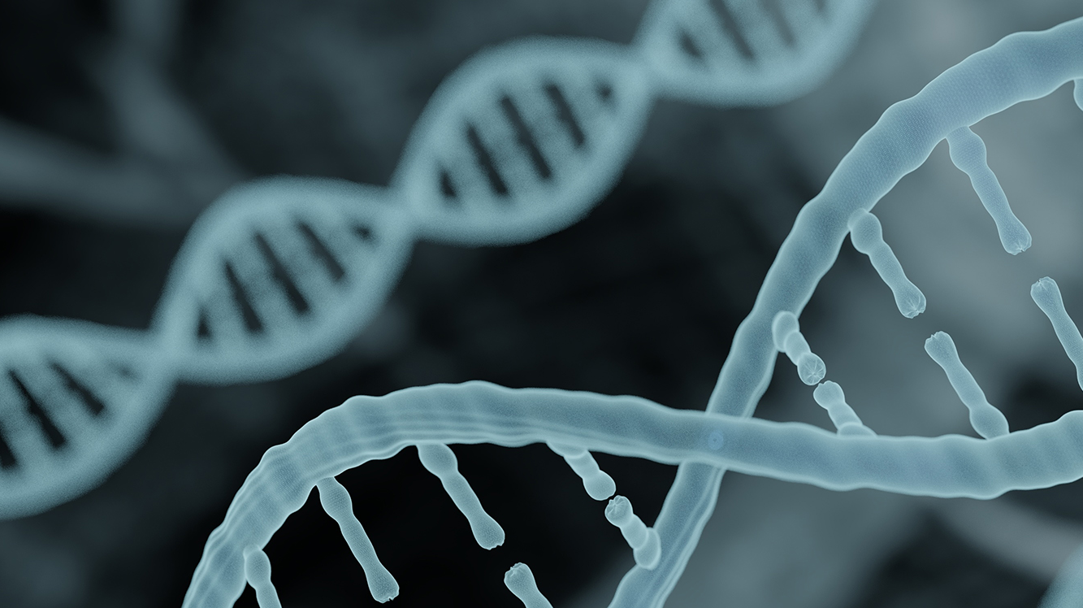
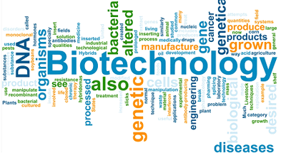
What is BIOTECHNOLOGY
De Silva G.S.N
SC1172 – INTRODUCTION TO
information technology

Slide 2

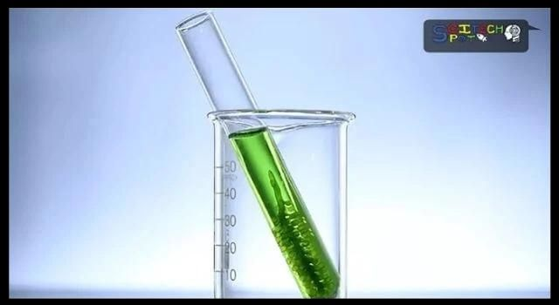
WHAT IS BIOTECHNOLOGY ? Bio + Technology = Biotechnology
Any technological application that uses biological systems, living organisms, their components or constituents to make or modify product or processes for specific use like generate useful products/service to enhance human welfare.
Definition from convention on biological diversity: https://www.cbd.int/

Slide 3
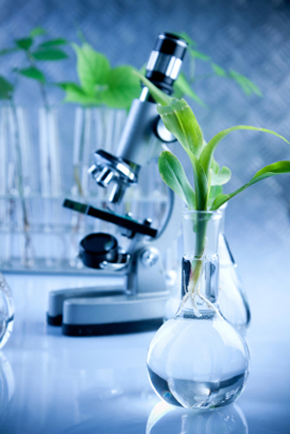
Areas of biotechnology
Marine biotechnology
Industrial biotechnology
Medical biotechnology
Forensic biotechnology
Food biotechnology
Biotechnology
Agricultural biotechnology
Environmental biotechnology
Aquatic biotechnology
Notes:
Red biotech ,Blue biotech ,Green biotech ,yellow biotech ,Brown biotech , Purple biotech ,White biotech

Slide 4
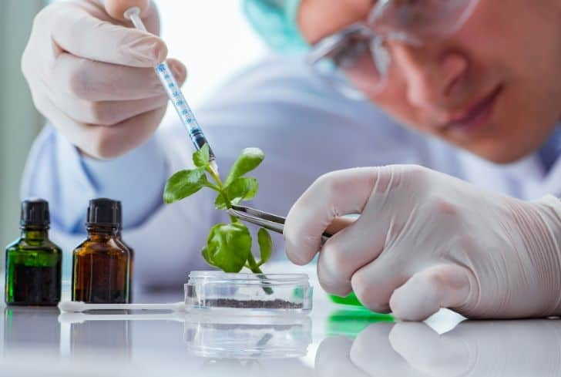
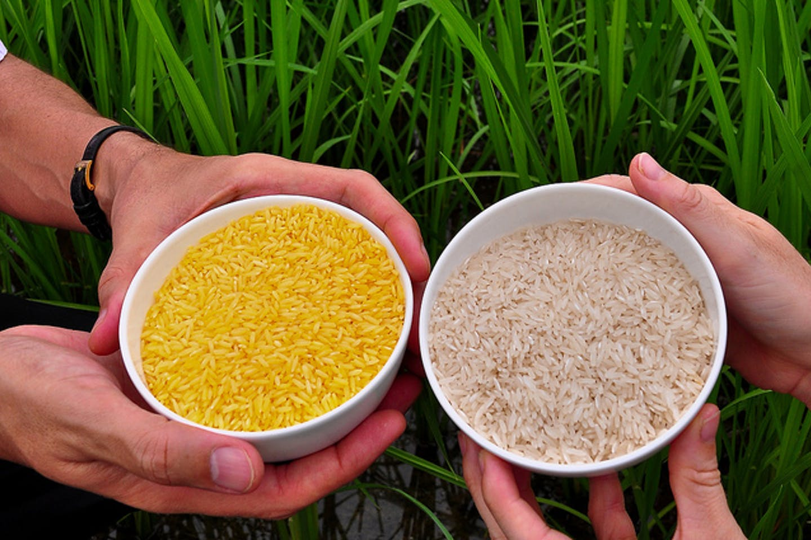
Nutrient supplementations (Food biotechnology)
One of the most important use of biotech.
Infusion of nutrients into food.
This product provides food with heavy nutrients that are necessary for such circumstances.
Golden rice= Rice is infused with beta carotene and rich with vitamin A

Slide 5

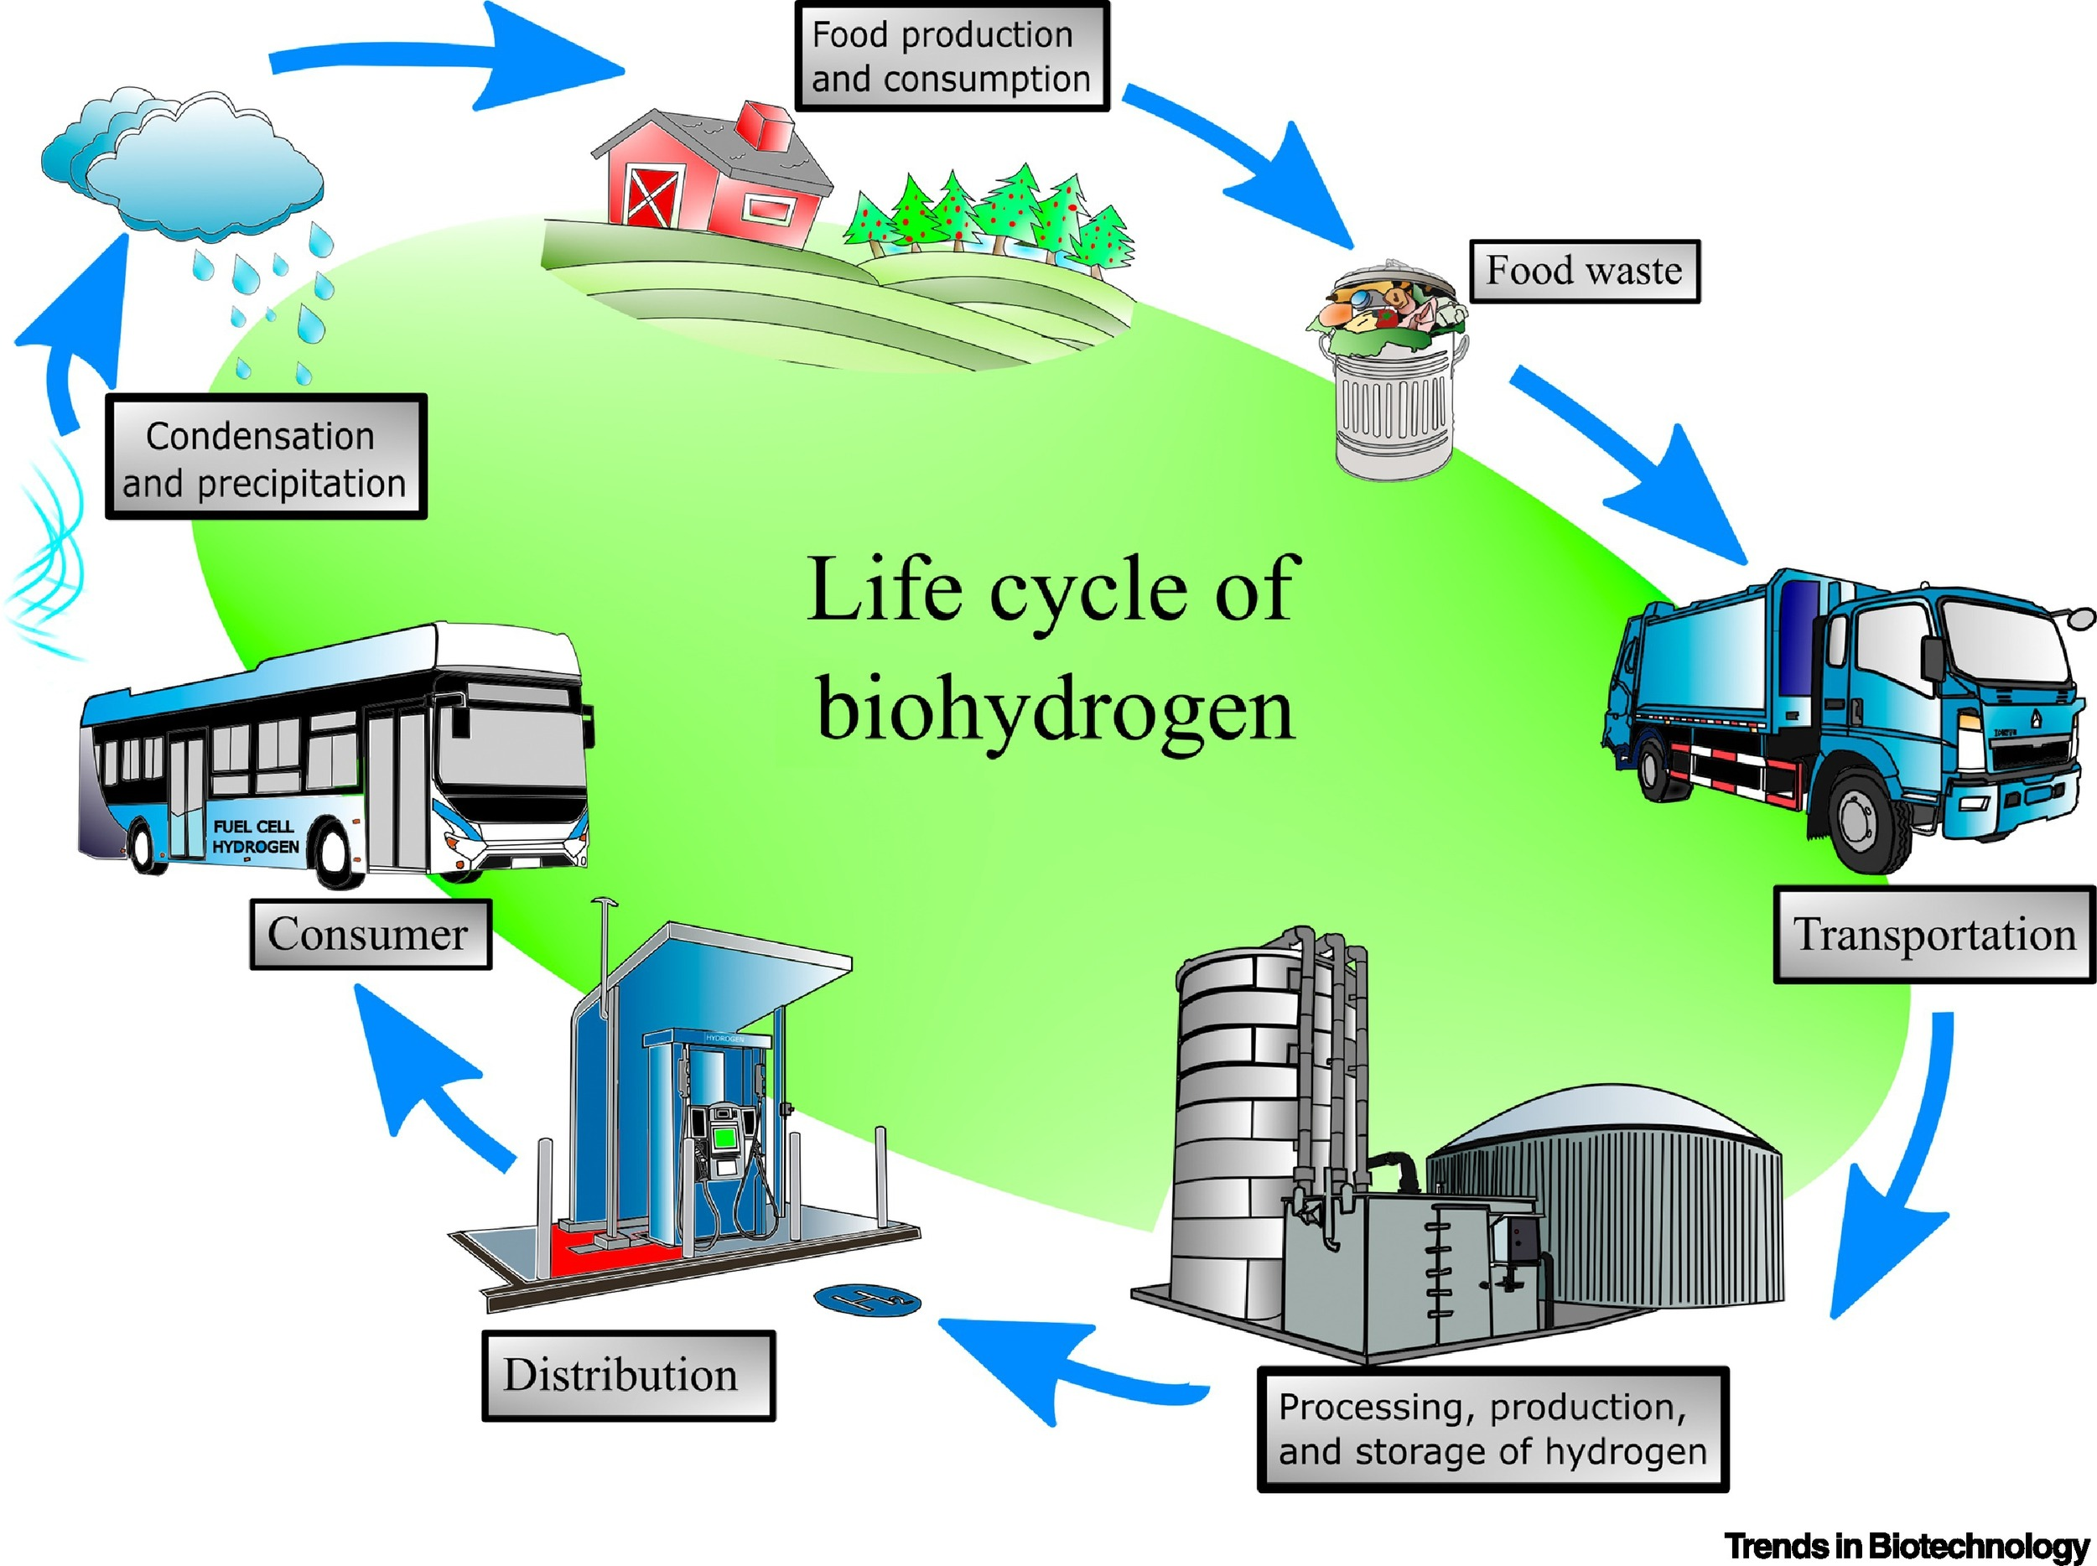
Fuel from waste (INDUSTRIAL BIOTECHNOLOGY)
One of the biggest applications of biotech is in the energy productions sector.
Environmentally friendly fuel sources.
This fuel is good for the environment as they do not produce greenhouse gasses
Applying bioremediation waste can be converted to biofuel to run generators.

Slide 6
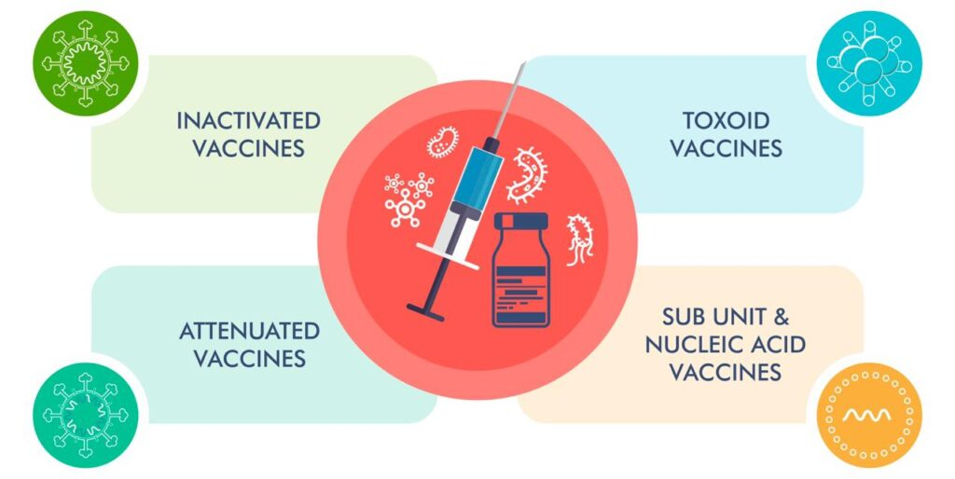
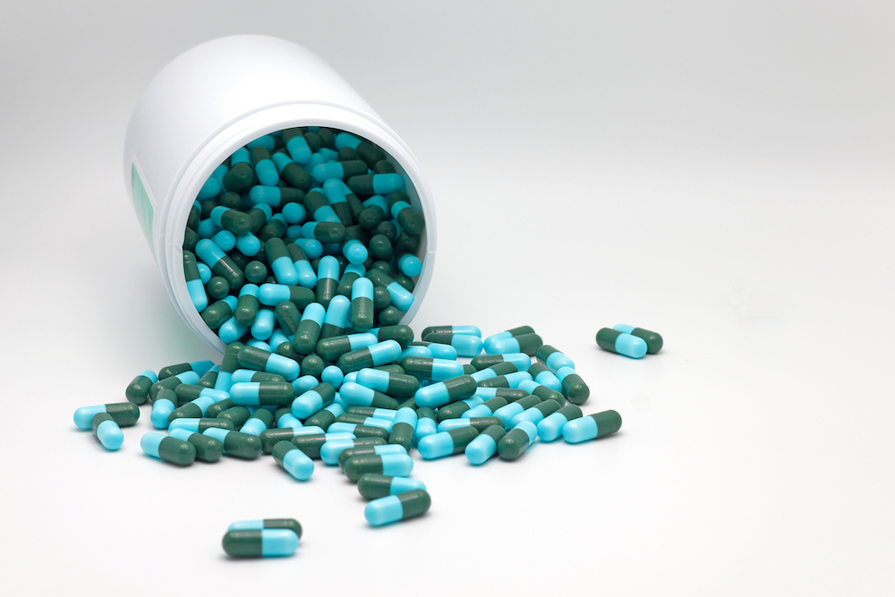
Vaccine & antibiotics (MEDICAL BIOTECHNOLOGY)
Vaccine
Vaccines are chemicals that stimulate the body’s immune system.
It causes the body to react as if it was under attack from the non attenuated versions of the disease.
This translates to quicker healing and less time being symptomatic.
Antibiotics
Antibiotics are commonly used in these days as a result of medical biotechnology.
Many plants are grown and genetically engineered to produce the antibodies.

Slide 7
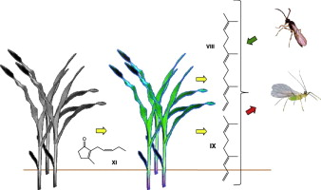
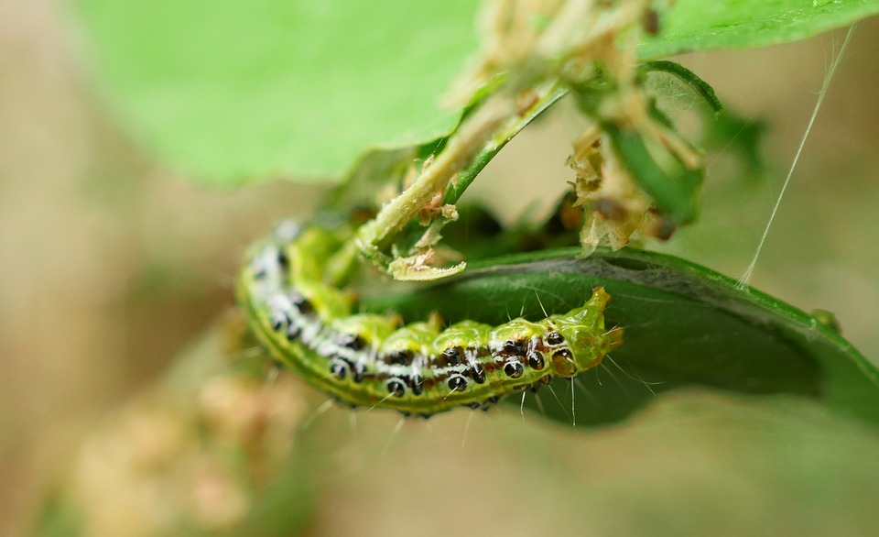
Pest resistant crops (AGRICULTURAL BIOTECHNOLOGY)
Biotechnology has provided techniques for the creation of crops that express anti pest characteristics naturally.
Making them very resistant to pests.
ex: Bacillus thuringiensis genes being transferred to crops.
Agricultural biotechnology focuses on developing pest resistant crops and as well as increase crop yields too.

Slide 8
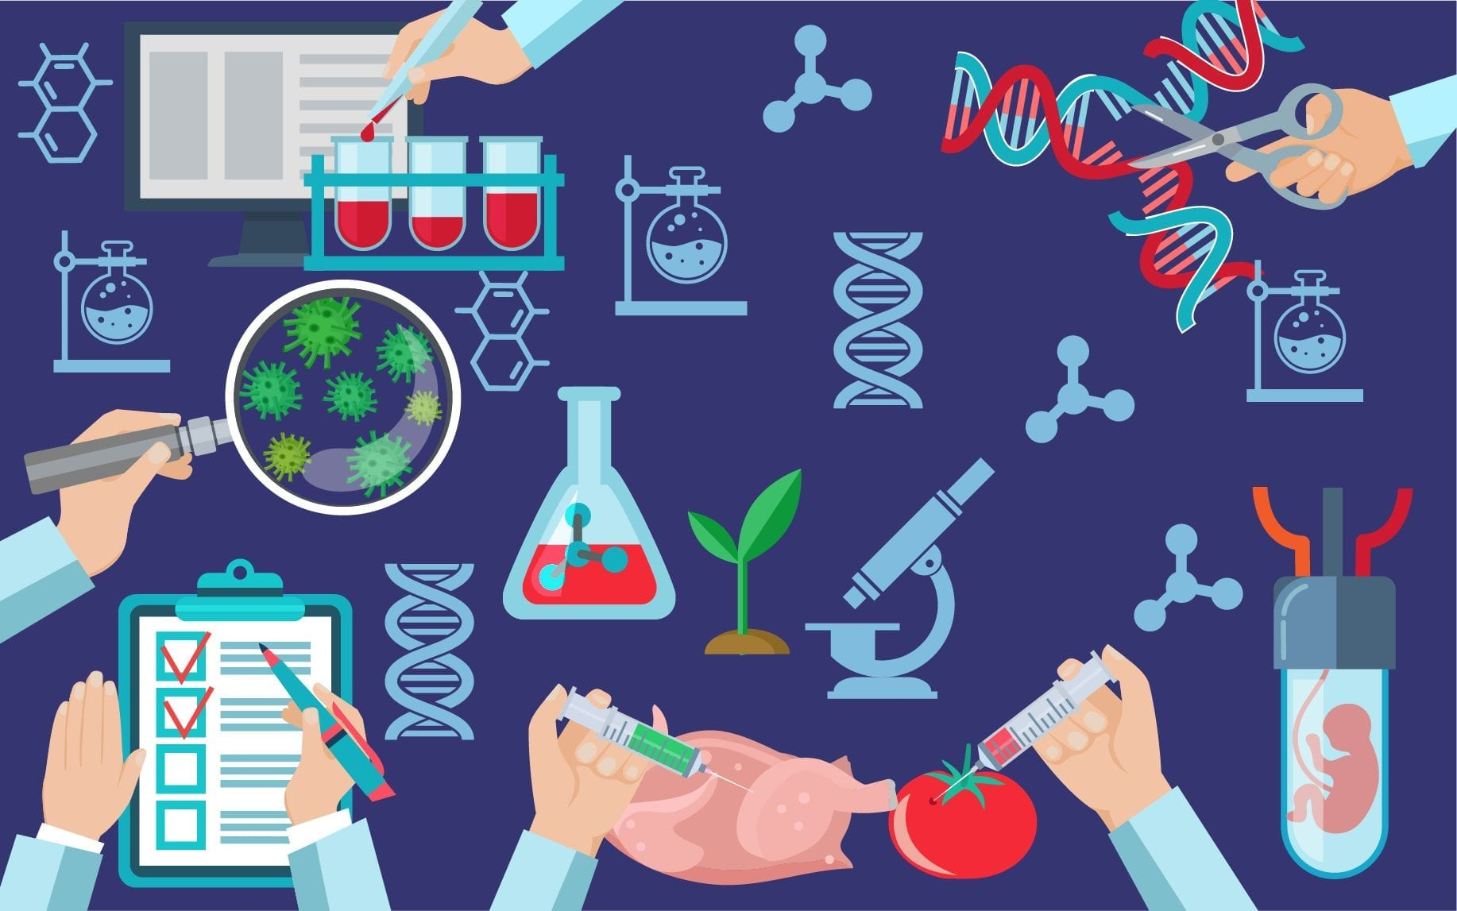

REFERENCES:
https://www.conserve.energy.future.com
https://en.Wikipedia.org
https://www.nesa.edu

